Slide 1
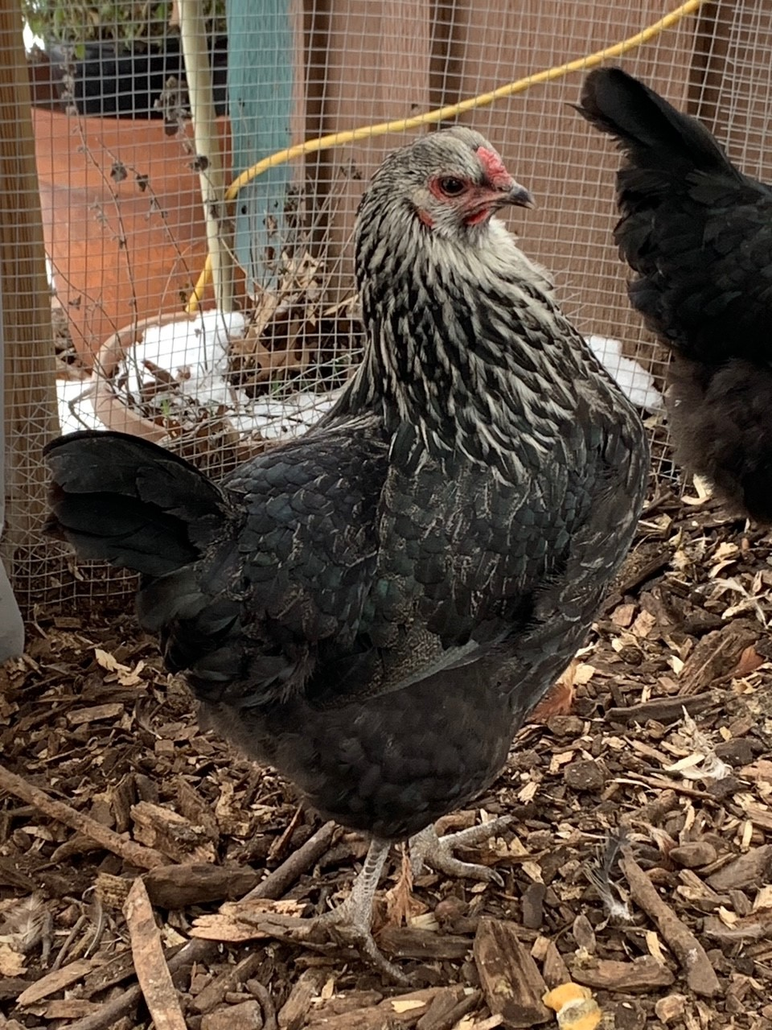
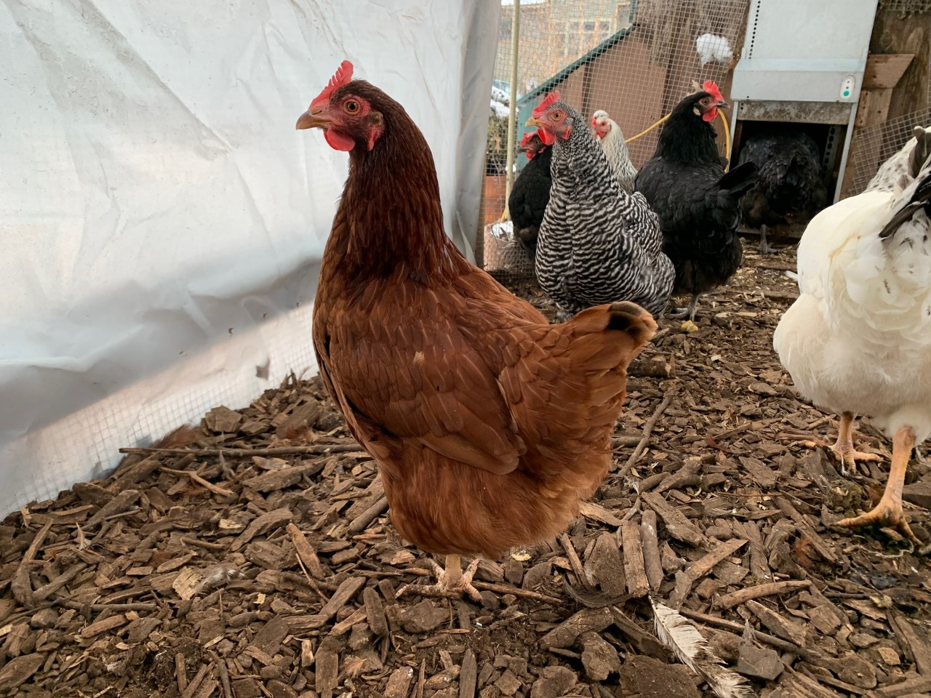
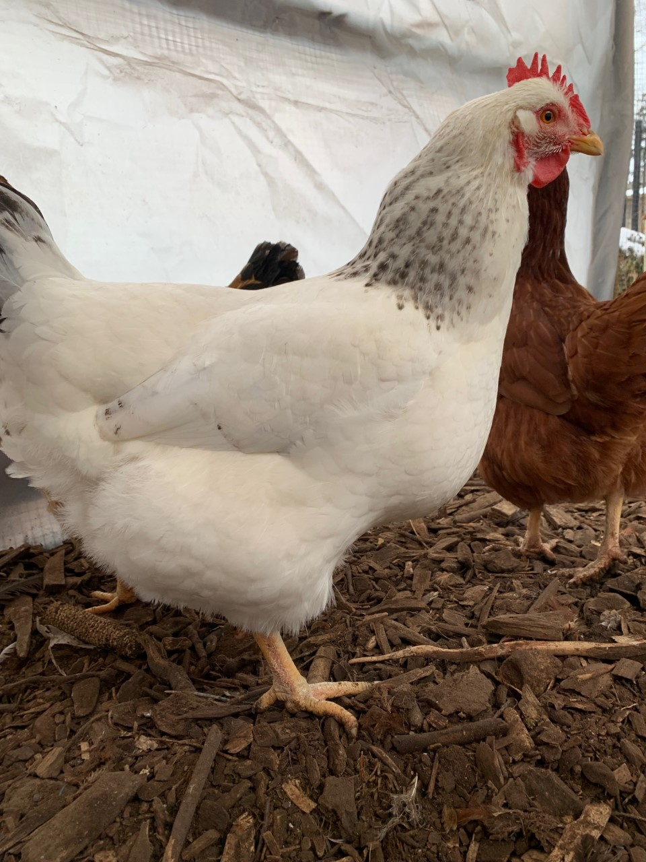
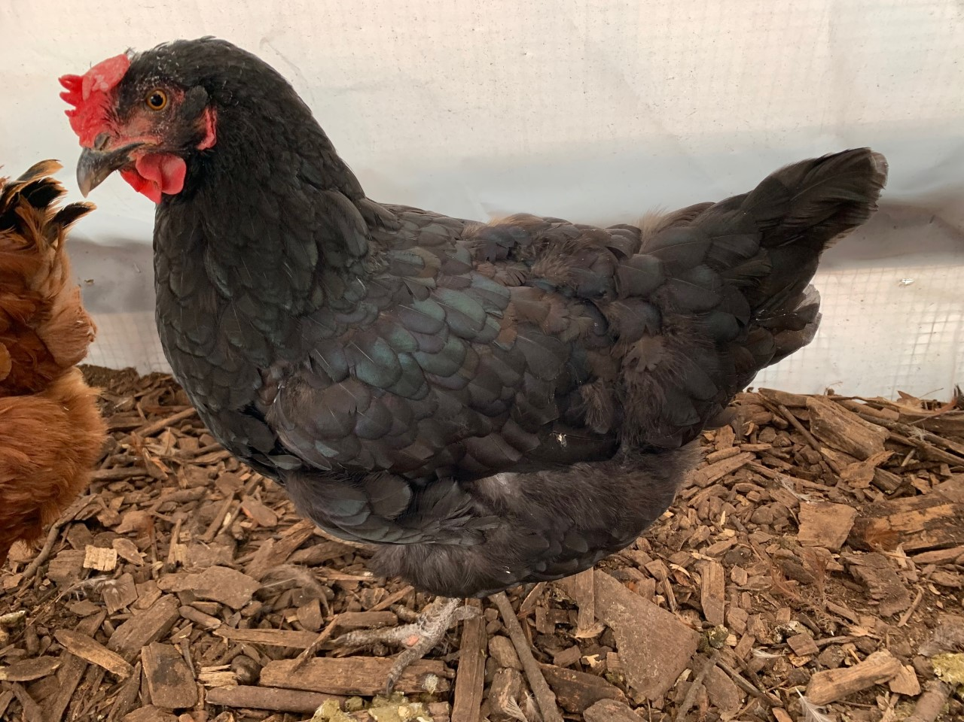
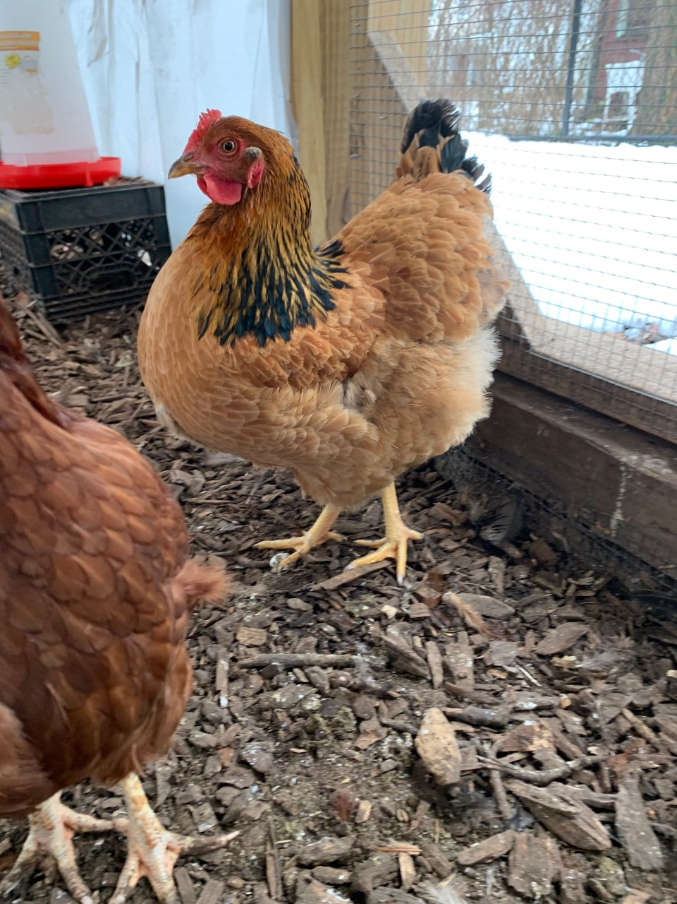
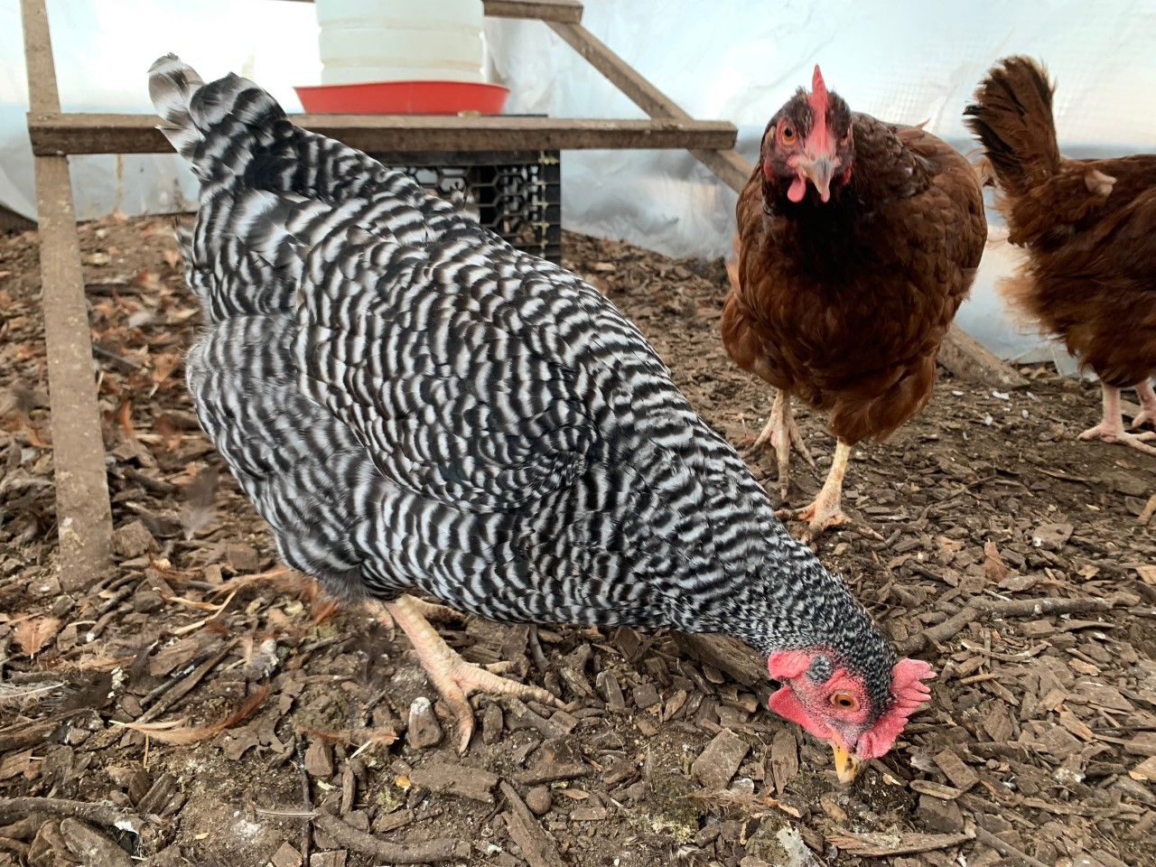
What breed is my chicken?
4H of Essex County Chicken Club
February 11, 2022

Slide 2
What breeds of chickens are at the Montclair Community Farm?
The 4H of Essex County Chicken Club members volunteer to care for the chickens at the Montclair Community Farm. There are seven different breeds on the farm. This winter, the Youth Members (grades 4-7) studied chicken anatomy and each member researched a different chicken to identify the various breeds.
They observed characteristics of the anatomy and the temperament to determine each breed. The members then presented their research and also gave their chickens a “farm name.”
4H of Essex County Chicken Club
February 11, 2022

Slide 3
“Stripey” Breed: Wyandotte Club Member: Arlie

Slide 4
“Coco”
Breed: Rhode Island Red Club Member: Cate

Slide 5
“Smokey” Breed: Australorp or Rhode Island Red Club Member: Holt

Slide 6
“Oreo”
Breed: Iowa Red Club Member: Emmy

Slide 7
“Vanilla Cupcake”
Breed: Light Sussex Club Member: Naomi

Slide 8
“Zebra”
Breed: Plymouth Rock Club Member: Molly

Slide 9
“Sally”
Breed: New Hampshire Red Club Member: Ms. Trina, club co-leader

